Slide 1
comparison for distribution for each position in Basketball
Sherod Brooks
Senior Mathematics Capstone Project
Faculty Advisor: Dr. Seonguk Kim

Slide 2
AGENDA
Abstract
Project goals
​Process of Project
Basketball Information
Mathematical Analysis
​Coding Work

Slide 3
Abstract
We used data analysis through multiple platforms to gain insights on what NBA teams can look for when they are deciding who they should draft. We used mathematical tools such as normal distribution to get those insights and we used pandas, excel, and other tools to visualize and explain our findings.

Slide 4
Project GOALS
finding the distributions of FG, 3PT, 2PT, FT for each position

Slide 5
Process of the project
Initially was a data analysis project(explain)
First we got the data from Kaggle(explain)
Then put the data into Excel and cleaned and transform the data(explain)
With that new and cleaned data we put it into pandas(explain)
Then lastly we put the data into power bi to get some really thorough visualizations

Slide 6

Basic basketball Info
NBA/College/Overseas Explain
NBA Draft
FG% , 3P% , 2P% , FT%
This Photo by Unknown Author is licensed under CC BY-NC-ND

Slide 7
Mathematical analysis
Normal Distribution Explained
A normal distribution, also known as the Gaussian distribution, is a probability distribution that is symmetric about the mean. It shows that data near the mean are more frequent in occurrence than data far from the mean. In graphical form, the normal distribution appears as a "bell curve". The normal distribution is used to analyze data when there is an equal chance for the data to be above and below the average value of the continuous data.

Slide 8
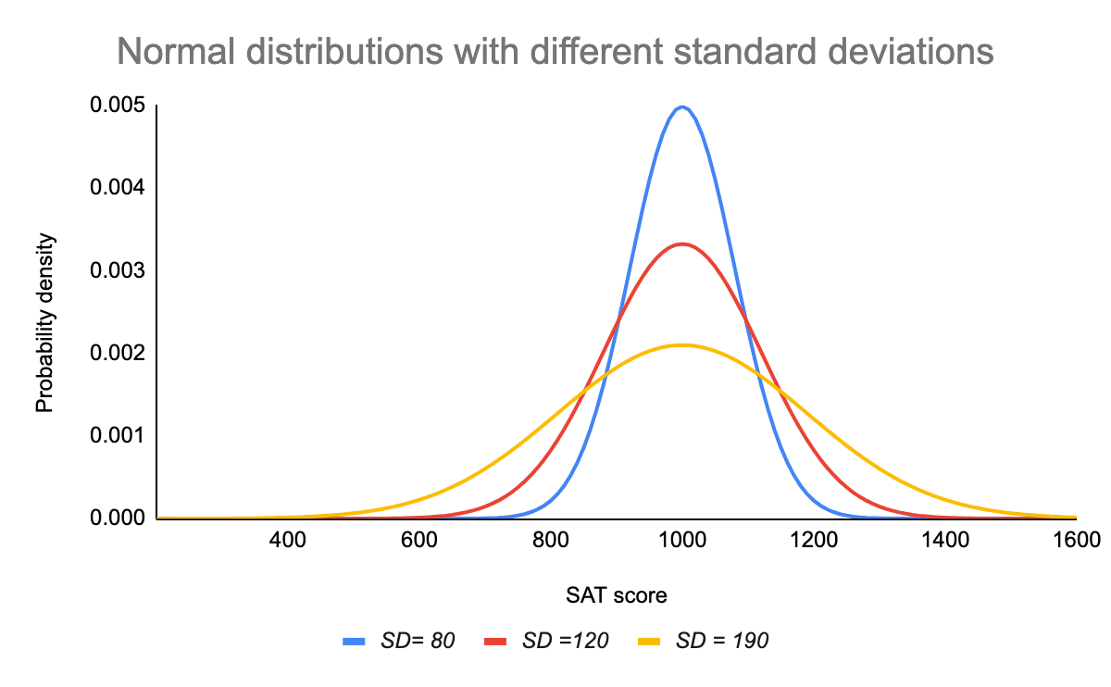
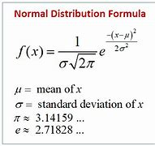
Standard Deviation: is a measure of variability. It defines the width of the normal distribution and determines how far away from the mean the values tend to fall
Mean(Average): the central tendency and defines the location of the peak of the bell curve, is also the median and mode.

Slide 9
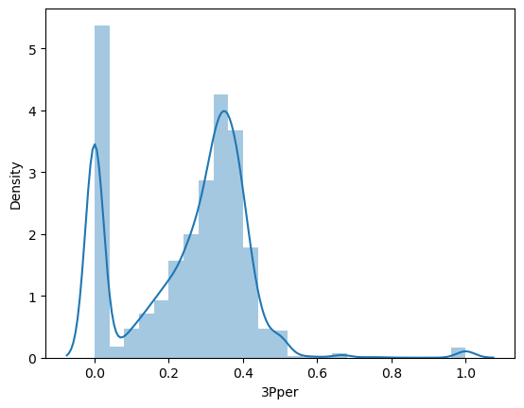
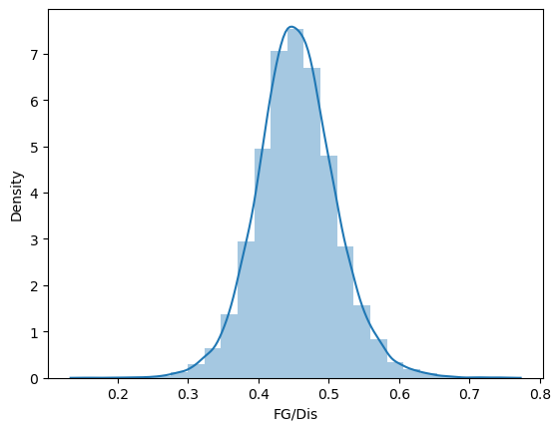
Mathematical analysis Cont.
Distributions by Position

Slide 10
Coding work
Kaggle
Excel
Pandas
Power BI

Slide 11
Work Cited
Frost, Jim. “Normal Distribution in Statistics.” Statistics By Jim, 6 Oct. 2023, statisticsbyjim.com/basics/normal-distribution/.

